Slide 1
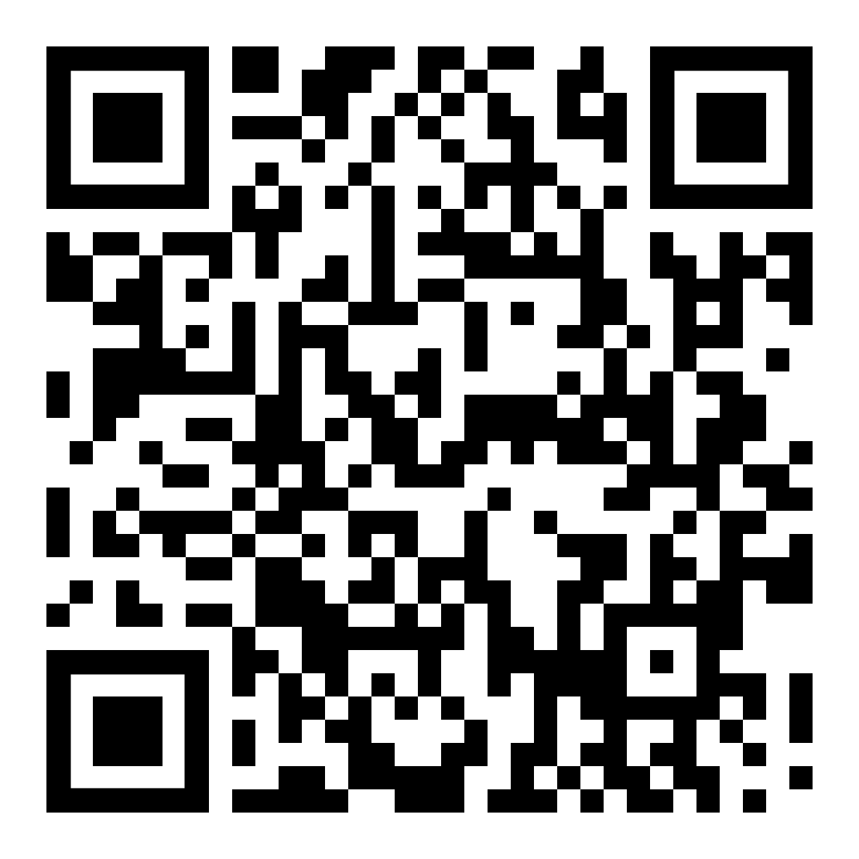
Graduate teaching assistant fidelity of implementation in introductory physics laboratories
Annalisa Smith-Joyner and Joi Walker
Department of Chemistry
Heather Hundley, Mark W. Sprague, Steven F. Wolf
Department of Physics
AAPT Meeting 2019
Provo, UT
Notes:
Put on QR code

Slide 2
Laboratory Reform
Award No. 1725655
Notes:
Transform laboratories in chemistry, biology & physics with the argument-driven inquiry instructional model, using similar language and artifacts in all three disciplines to introduce and engage students in important science practices

Slide 3
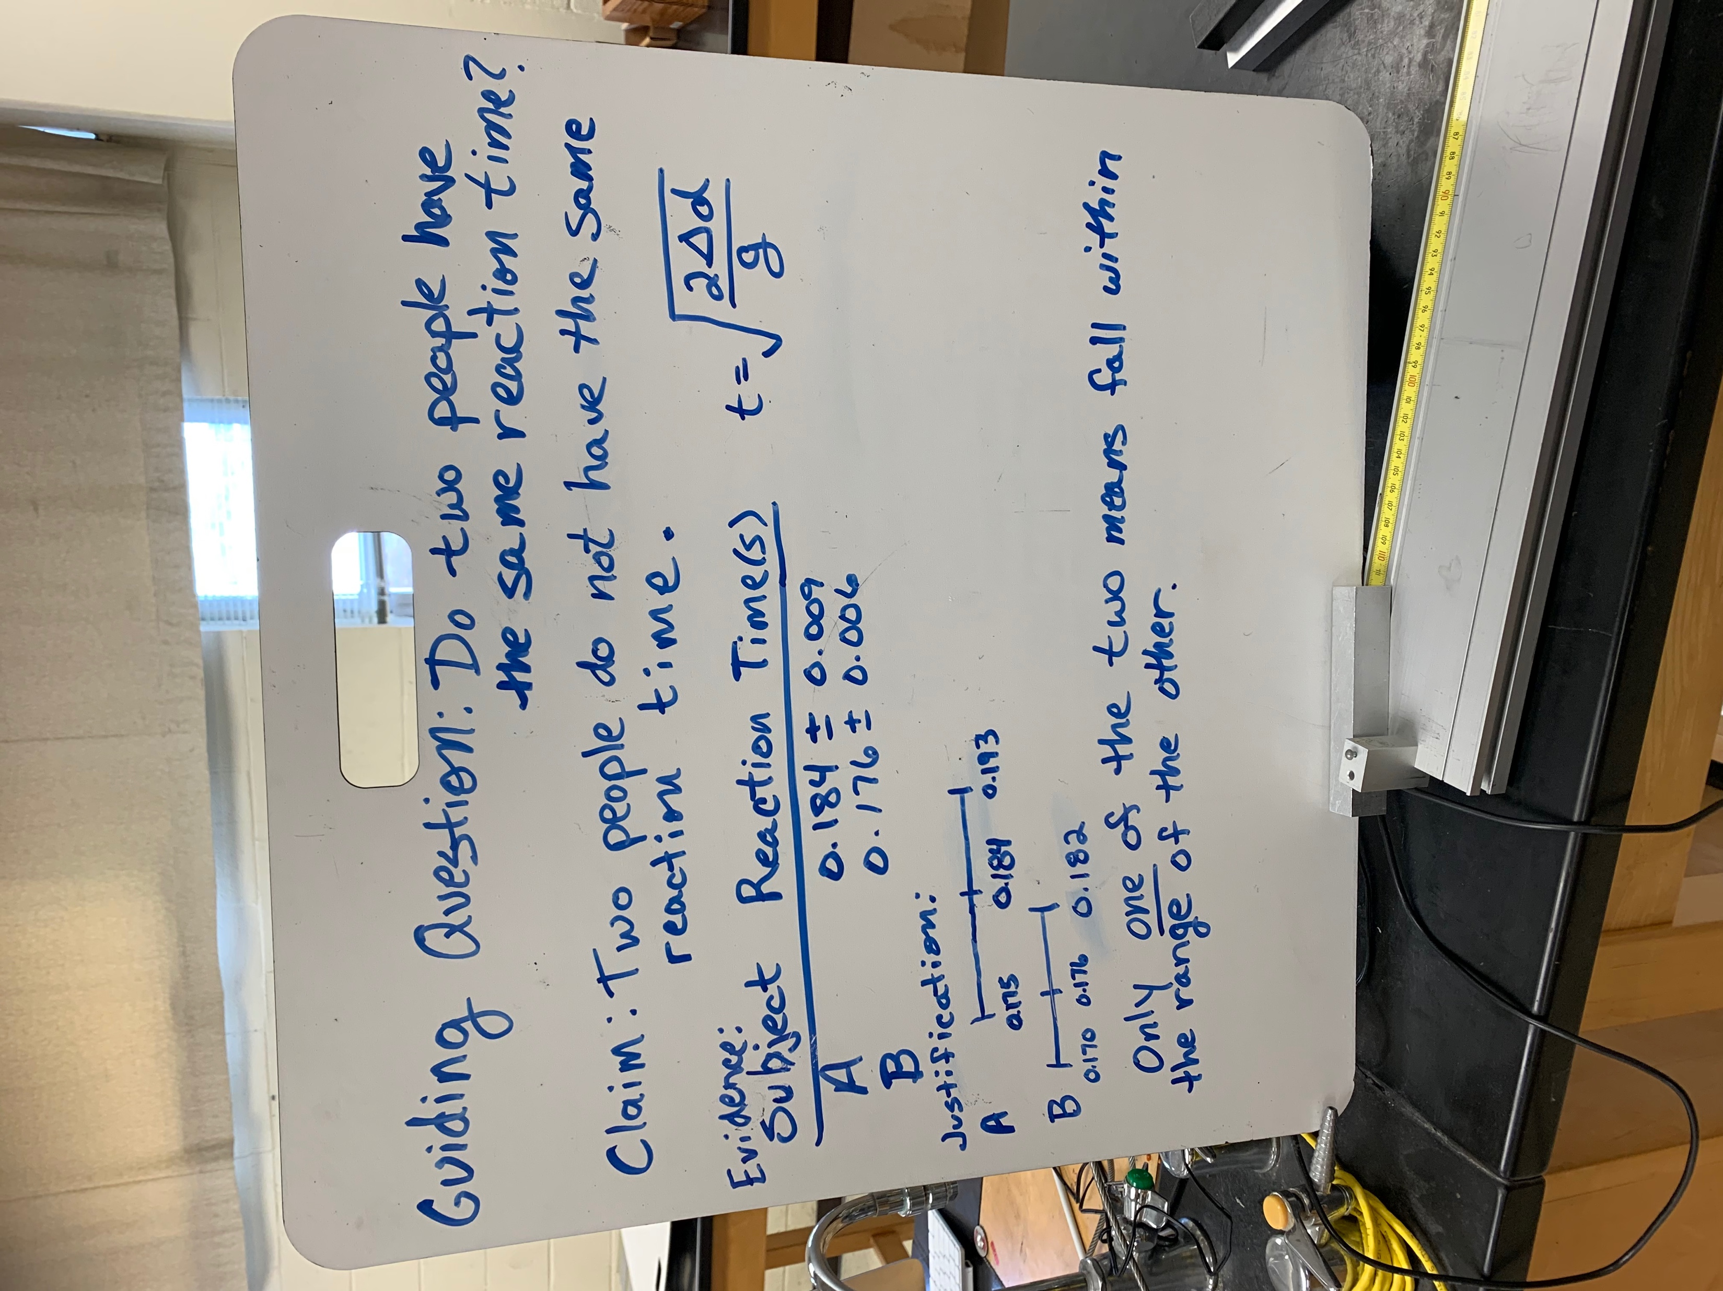
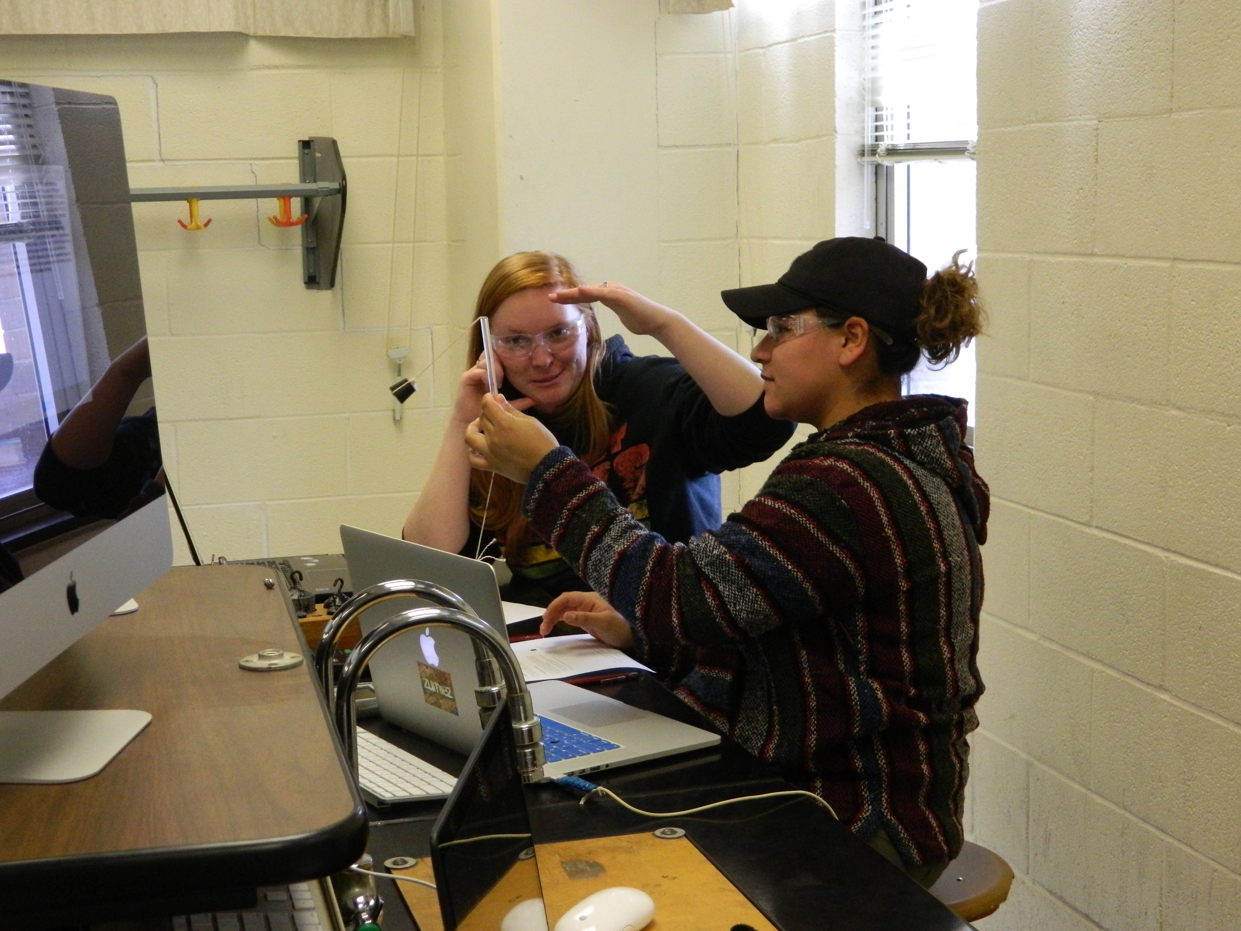
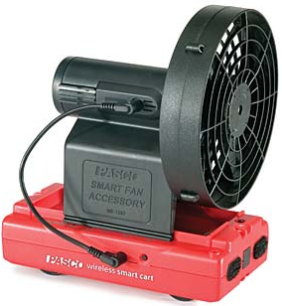
Argument-Driven Inquiry
Week 3
Finish Data collection and Argumentation session
Week 2
Proposal Approval and Inquiry Investigation
Before Week 4
Online Peer Review and revision
Week 1
Pre-lab Investigation
Does the force that the fan exerts depend on the mass of the cart?
Notes:
1D Motion lab picture with GQ

Slide 4
Research Question
Science Practice
Asking Questions
Developing & Using models
Conducting Investigations
Analyzing & Interpreting Data
Using Mathematics & Computational Thinking
Constructing Explanations
Engaging in Scientific Argument
Evaluating & Critiquing Ideas
How does graduate teaching assistant (GTA) implementation of Argument-Driven Inquiry impact student performance on an end-of-course lab practical in introductory physics?
Notes:
Student performance with science practices as outlined by NGSS

Slide 5
Context
Primarily undergraduate university in southeastern United States
Fall semester of 2018
26 sections with 22 students
Graduate teaching assistants facilitate
Notes:
16 weeks (University was closed down for 8 days due to natural disaster during 1st investigation), 1st investigation, one in middle, & last. Observed 2 GTAs in one section(taught 3 sections)

Slide 6
GTA Role
Stage | ADI Model | Traditional Model
Task Identification | Discuss the guiding question | Lecture on how to perform the experiment that has known results to GTA and student
Collect & Analyze Data | Facilitate student investigation design with guiding questions | Answer questions & provide information to produce results with a high correlation
Argument Development | Suggest that there may be inconsistency with the data | Review the data and inform the student how to improve it
Argumentation Session | Shadow group discussions with minimum feedback | Not applicable
Lab Report Development | Stress that while this is a draft, the students should provide a complete draft to benefit from the peer review | Grades the first attempt of evidence and justification
Report Revision | Use a standard rubric to score the edited lab report | Not applicable
Notes:
Remain neutral

Slide 7
Observation Protocol
Developing a Proposal
SC | Instructor asks guiding questions
 | Instructor checks on whole class progress
 | Instructor explicitly answers all questions
IC | Instructor outlines the procedure
Collection of Data
SC | Instructor checks on whole class progress
 | Instructor checks on group progress
 | Instructor gives some aid and offers suggestions in data collection
 | Instructor interjects and directs data collection
 | Instructor demonstrates how to collect data specifically
IC | Instructor helps assess validity of data
Notes:
Match colors to graphs on next slide

Slide 8
GTA Comparison
GTA questioned a presenter about velocity, mass, trials, and error. The travelers listened to the GTA talk, but did not ask any questions until the GTA had gone to another group.
GTA handed a 1 kg weight to a student that stated the force was ~75 N. The GTA explained that the weight was ~10 N with gravity and then asked the presenter & travelers what units were in a N.
GTA was observing the groups from the front of the room and was available if the students needed assistance.
GTA told students to document what fan setting and how many weights they used.
GTA asked students what they were measuring when an issue was spotted with the proposal.
GTA was disengaged, unavailable to the students, and was working on homework for another class.
Notes:
Pop up 1 at a time

Slide 9
Scoring Validity
Standard rubric
All scores were validated by research team
Established inter-rater reliability
Equivalent medians
Significant correlation coefficient (greater or equal to 0.871, p < 0.05)
Notes:
Scores: presented on the following slides, IRR: tested 25%, Pearson’s correlation coefficient (look at pic, highlight what I want, 0.912)

Slide 10
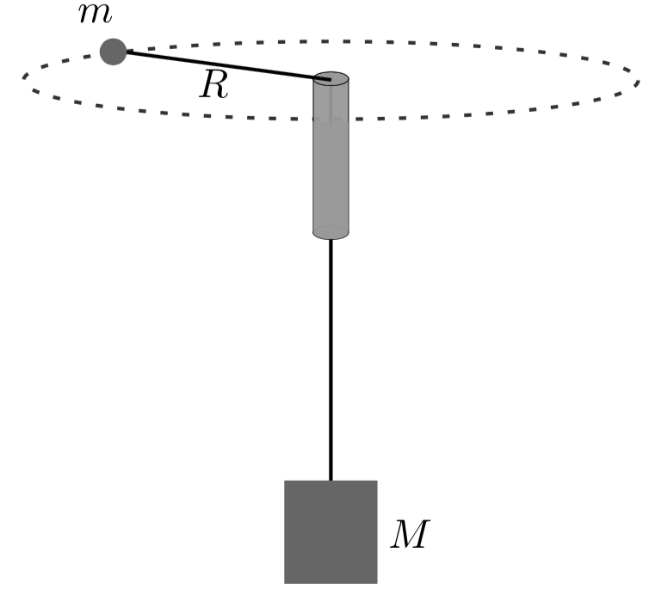
Lab Practical
Determine relationship between hanging mass & period
Design investigation
Collect & analyze data
Make a claim
Write scientific argument
Steven Wolf PST1D30
Monday 8:30-9:15pm
Notes:
Refer to poster session AAPT and PERC (Dr. Wolfs, poster # look in cataloque)

Slide 11
Lab Practical Results
*
73.32
83.15
*Indicates a significant difference
with a p-value <0.05
Notes:
Sig. diff. with p <0.05

Slide 12
Implications
Based on findings from this study, GTA proficiency influences the facilitation techniques implemented; which in turn appears to be correlated with improved student performance on the end-of-course practical.

Slide 13
Notes:
QR Code

Slide 14
References
[1] N. G. Holmes, J. Olsen, J. L. Thomas, and C. E. Wieman, Value added or misattributed? A multi-institution study on the educational benefit of labs for reinforcing physics content, Physical Review Physics Educ. Res. 13, 1 (2017), 010129-1.
[2] N. Reid and I. Shah, The role of laboratory work in university chemistry, Chem. Educ. Res. and Pract. 8, 2, 172 (2007).
[3] National Research Council, Discipline-based education research: Understanding and improving learning in undergraduate science and engineering, Washington, DC: The National Academies Press, (2012), doi:10.17226/13362
[4] T. M. Addy and M. R. Blanchard, The Problem with Reform from the Bottom up: Instructional practises and teacher beliefs of graduate teaching assistants following a reform-minded university teacher certificate programme. International Journal of Science Education 32, 8, 1045 (2010).
[5] K. Burke, B. Hand, J. Poock, and T. Greenbowe, Using the science writing heuristic: Training chemistry teaching assistants. Journal of College Science Teaching. September, 31 (2005).
[6] D. Sawada, M. Piburn, E. Judson, J. Turley, K. Falconer, R. Benford, and I. Bloom, Measuring reform practices in science and mathematics classrooms: The reformed teaching observation protocol, School Science and Mathematics 102, 6, 245 (2002).
[7] N. L. States, Next generation science standards: For states, by states (2013).
[8] S. W. Rissing and J. G. Cogan, CBE-Life Sciences Education 8, 55 (2009).
[9] R. Driver, H. Asoko, J. Leach, P. Scott, and E. Mortimer, Educational researcher 23, 5 (1994).
[10] J. P. Walker, V. Sampson, and C. Zimmerman, Argument-driven inquiry: An introduction to a new instructional model for use in undergraduate chemistry labs. J. of Chem. Ed. 88, 10, 1048 (2011).

Slide 15
References (Cont)
[11] M. J. Ford, Disciplinary authority and accountability in scientific practice and learning, Science Education 92, 3, 404 (2008).
[12] E. Etkina, A. Karelina, M. Ruibal-Villasenor, D. Rosengrant, R. Jordan, and C.E. Hmelo-Silver, Design and reflection help students develop scientific abilities: Learning in introductory physics laboratories. Journal of the Learning Sciences 19, 1, 54 (2010).
[13] B. Thacker, K. Eunsook, T. Kelvin, and S.M. Lea, Comparing problem-solving performance of physics students in inquiry-based and traditional introductory physics courses. American Journal of Physics 62, 7, 627 (1994).
[14] J. P. Walker, V. Sampson, J. Grooms, C. Zimmerman, and B. Anderson, Argument-driven inquiry in undergraduate chemistry labs: The impact of students’ conceptual understanding, argument skills, and attitudes toward science. Journal of Science Teaching 41, 4, 74 (2012).
[15] J. P. Walker, V. Sampson, S. Southerland, and P.J. Enderle, Using Laboratory to engage all students in science practices. Chem. Educ. Res. Pract. 17, 1098 (2016), doi:10.1039/C6RP00093B
[16] J. P. Walker and V. Sampson Learning to argue and arguing to learn: Argument driven inquiry as a way to help undergraduate chemistry students learn how to construct arguments and engage in argumentation during a laboratory course. Journal of Research in Science Teaching 50, 5, 561 (2013).
[17] https://www.peergrade.io/ Retrieved 7/3/2019
[18] S. F. Wolf, M. W. Sprague, F. Li, A. Smith-Joyner, and J. P. Walker, Introductory physics laboratory practical exam development: Investigation design, explanation, and argument., submitted to PERC 2019.

